Slide 1


Slide 1
EXTENDED LEVEL BOOMERS

Slide 2
Trade
Act of Buying or Selling Something
Exchanging commodities
Stock Exchanges
Foreign exchanges
Stock Exchange?
Securities like shares are bought and sold at prices governed by forces of demand and supply.
New York Stock Exchange
NASDAQ - National Association of Securities Dealers Automated Quotation
London Stock Exchange

Slide 3
ETF?
Exchange Traded Fund
Marketable security that tracks stock index or a commodity
Price changes throughout the day
Moves in tandem with stocks

Slide 4
Slide 2
Extended Level Boomers? What’s that?
Concept
strongly trending markets pull back for a few days and then resume their trends
especially in the early stages of the move.
The pause can be in the form of sideways movement or a few down days.
Why does this happen?
traders/investors decide to lock in their profits
Buy at lower prices
Have short-term approach to the market
They use the pullback to continue to accumulate their positions at lower levels
prices moves higher and generate more momentum

Slide 5
Slide 2
RULES
Rule 1:
Day 1 makes 60 days high
Rule 2:
Next two days or beyond up to 5 days the stock prints inside days with reference to the day 1 high
Rule 3:
Following the two or more inside days, place a buy-stop one tick above the day 1 high
Rule 4:
If the stock trades below the day 1 low, cancel the order
Rule 5:
When filled, risk 1 point and use a trailing stop to lock in profits
2

Slide 6
Slide 3
Example of a Long Pattern

Slide 7
Slide 4
What happened in the previous example?
On 1/9/2002, the stocks made a new 60 days high
After the 60 days high on 9th of January, the trades are inside it for the next 4 days
5th day i.e. the 14th of January trades above the high of 9th January
Made 5 point profit

Slide 8
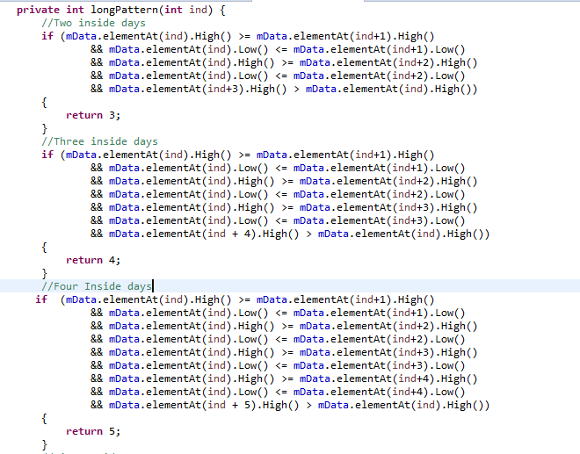
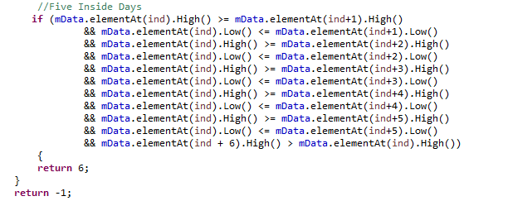
Slide 6
IMPLEMENTATION OF LONG PATTERN ON JAVA
Checking whether the pattern consists two inside days
Checking whether the pattern consists three inside days
Checking whether the pattern consists four inside days
Checking whether the pattern consists five inside days
6

Slide 9
Slide 3
Example of a Short Pattern

Slide 10
Slide 4
Explanation of previous example
On 1/10/2003, the stocks made a new 60 days low
After the 60 days low on 10th of January, the trades are inside it for the next 4 days
3rd day i.e. the 15th of January trades below the low of 10th January
HOW TO CODE SHORT SALES?
Short Sales Are Just Reverse Of Long Pattern

Slide 11
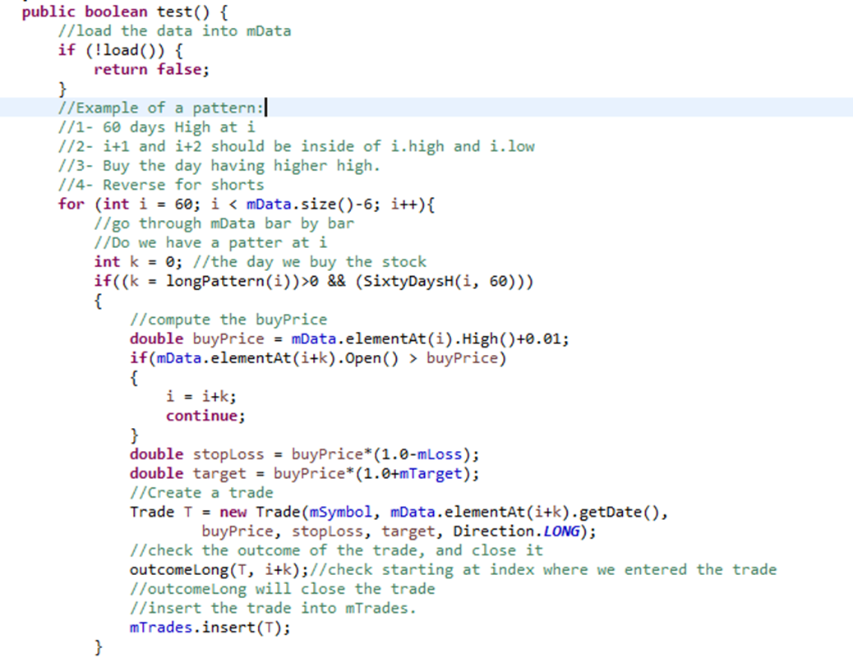
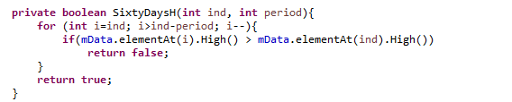

Slide 12
Checking the best combination
Loss
Target
0.01
0.02
0.05
0.1
0.0
0.01
0.02
0.05
0.1
0.0
17 total combinations

Slide 13
Big Main
Simulator
Calculation of Stocks
Calculation of ETFs
Stocks, ETFs Combination

Slide 14

Result Analysis
No. of long trades
No. of short trades
Stocks
Percentage of Winners
Holding Period
Loss
Target
ETFs
Average Profit/Loss
Percentage of Long Winners
Percentage of Short Winners
No. of Trades
Combination
Average Profit/Loss in Long trade
Average Profit/Loss in Short trade

Slide 15

BEST RESULT
Why?
Percentage of Long Trade winners and Short Winners are very high and close to each other
Profit ratio is positive which means it is a win case scenario.

Slide 16
Conclusion
ELB capitalizes on trade continuations which occurs after the markets rest
Risk is low
Rewards are substantial since we are trading a breakout pattern

Slide 17

Slide 11
THANK YOU

